Slide 1
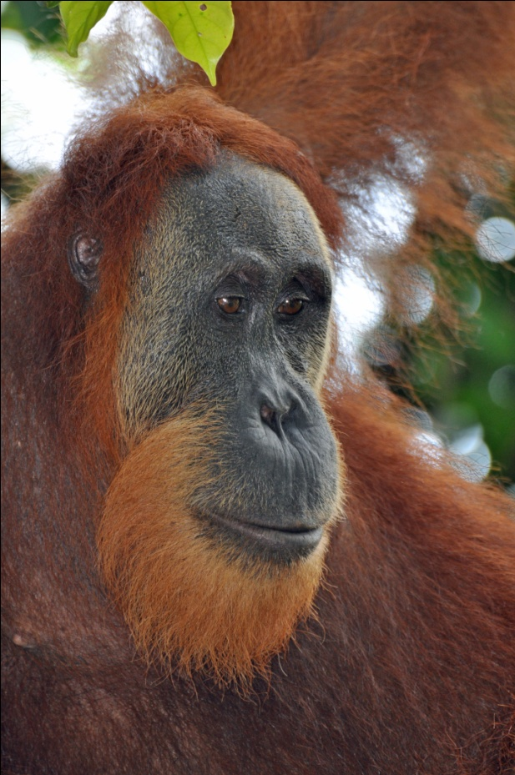
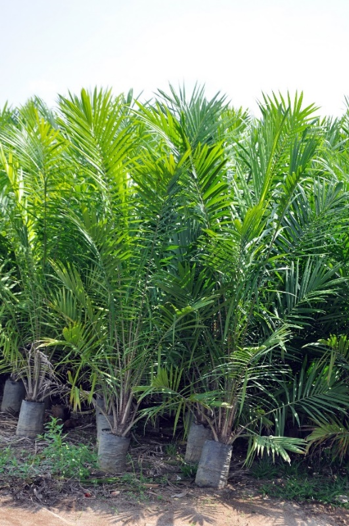



Palm Oil Awareness
Sharing resources for a unified message.
Learn what you can do!

Slide 2
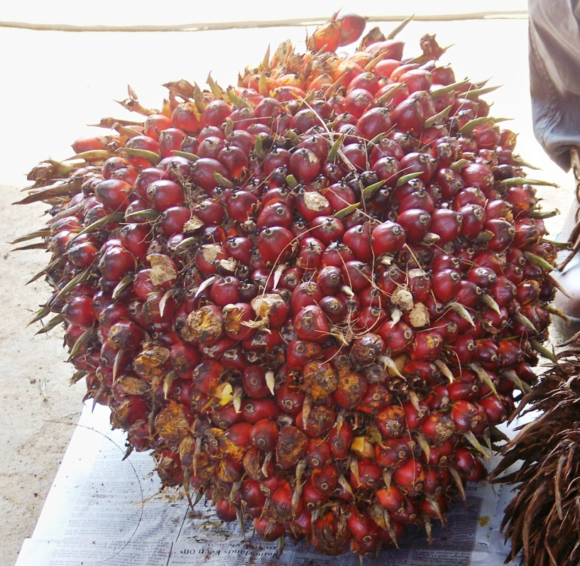
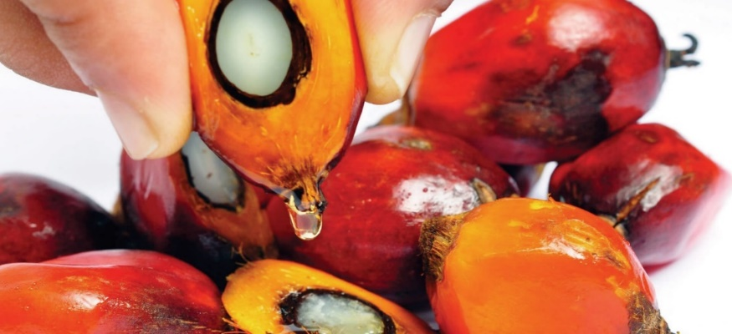
What is Palm Oil?
A commonly used vegetable oil
Found in about half of manufactured products at the store
More palm oil is produced and consumed every year than any other vegetable oil
In many food, cleaning, self-care and beauty products…and more!

Slide 3
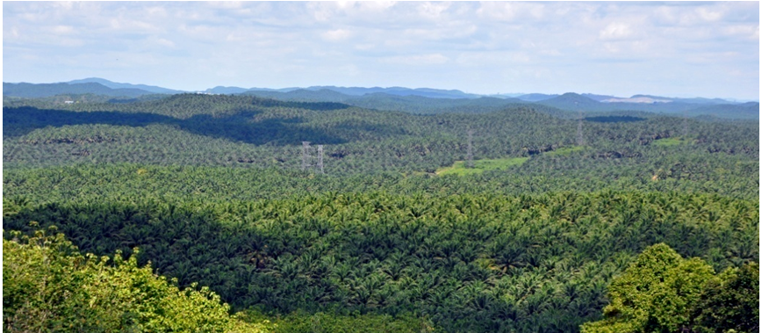
What is Palm Oil?
Oil palm is a plant native to Africa that grows well in tropical climates.
It is a crop introduced to Indonesia and Malaysia, not part of the rainforest.
An important part of the economy in Indonesia and Malaysia.

Slide 4
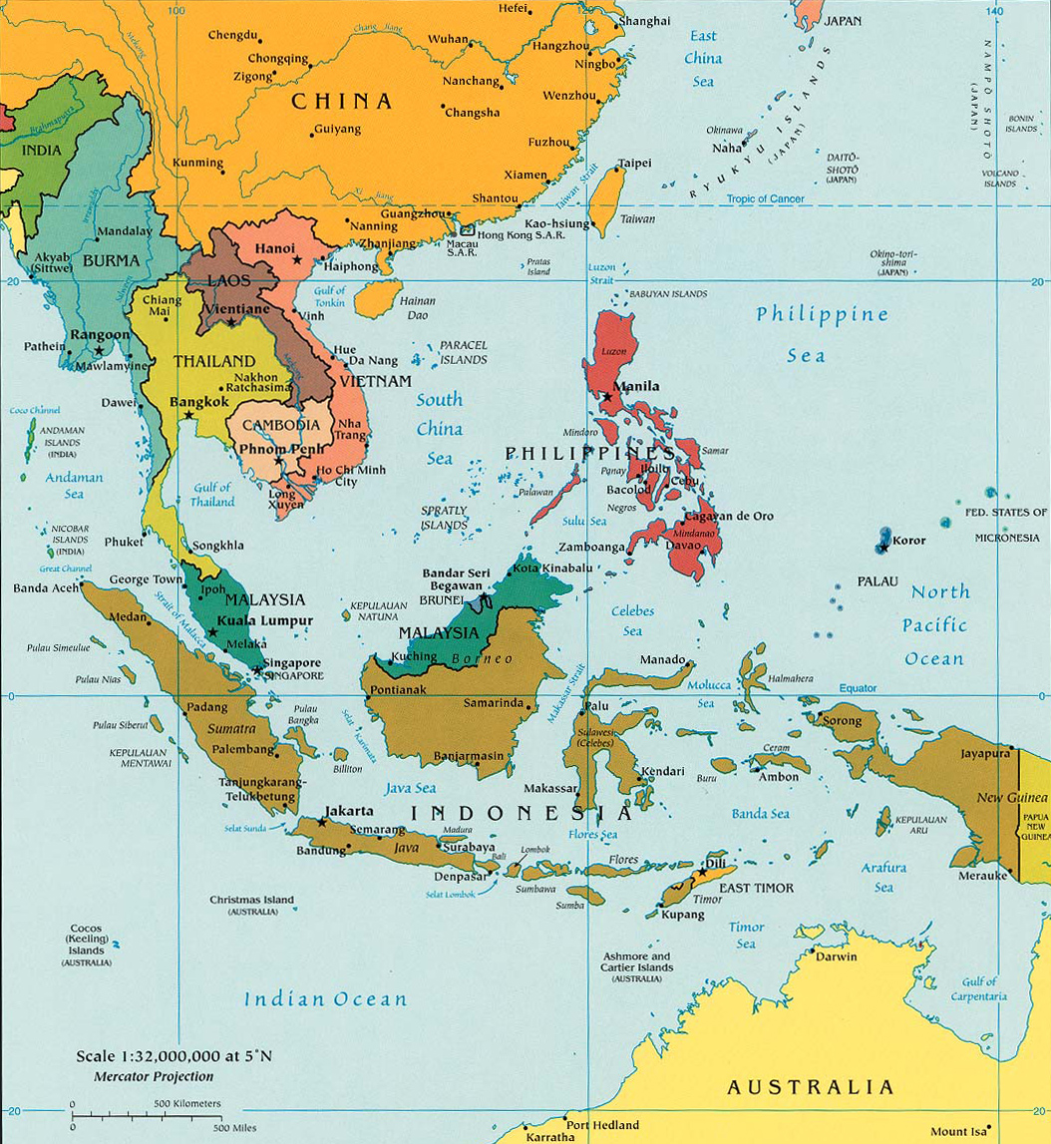
Where is the Majority of Palm Oil Grown?
Indonesia and Malaysia

Slide 5
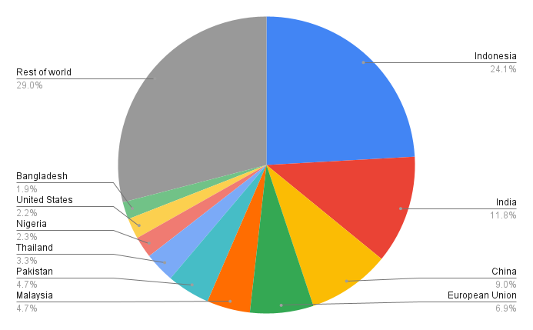
Global Palm Oil Consumption (2022/23)
The U.S. consumes about 2% of the palm oil produced worldwide.
Source: USDA Oilseeds: World Markets and Trade, November 9, 2022
Notes:
Source: https://apps.fas.usda.gov/psdonline/circulars/oilseeds.pdf

Slide 6
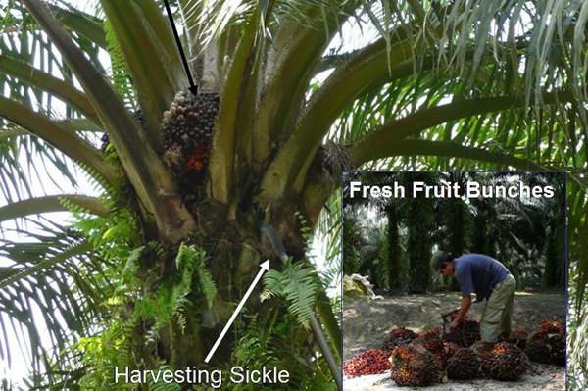
Harvesting Palm Oil
Fresh Fruit Bunch (FFB) ready for harvest

Slide 7
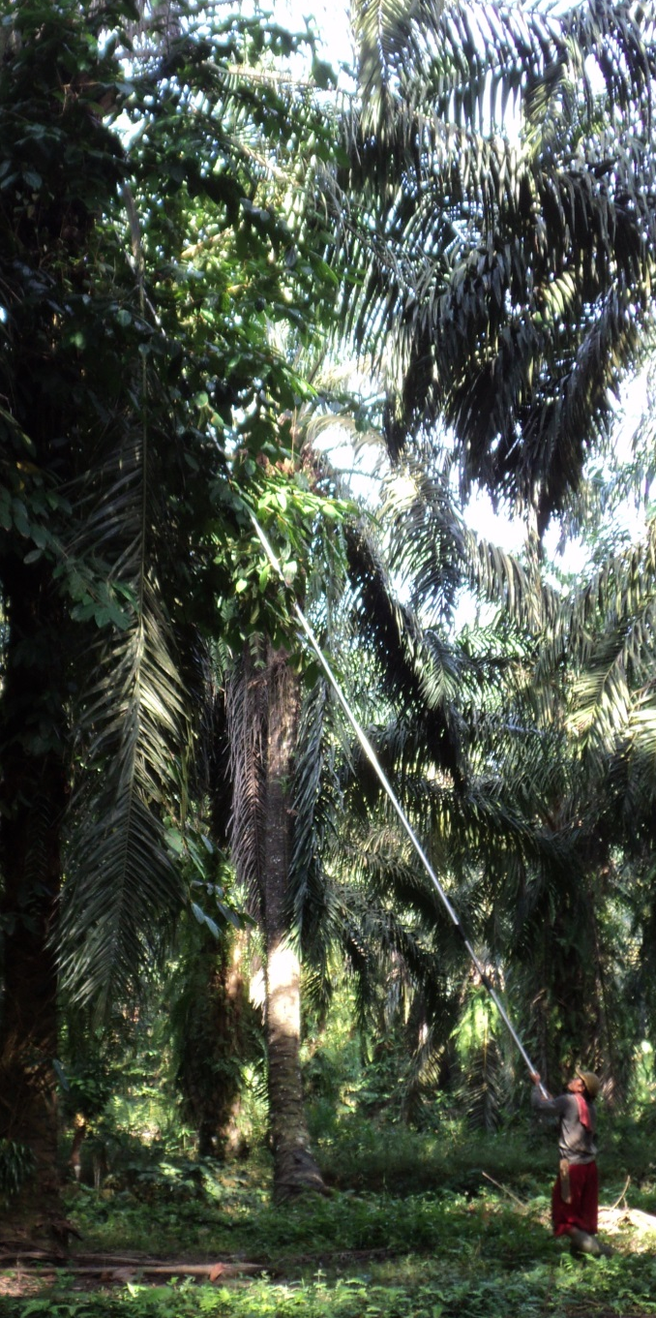
Harvesting Palm Oil
When oil palm plants are young & small the FFBs are easy to harvest.
When oil palms are 40 feet tall it takes a pole saw and incredible skill to harvest.
After an oil palm is ~25 years old it is too difficult to harvest (too tall).

Slide 8
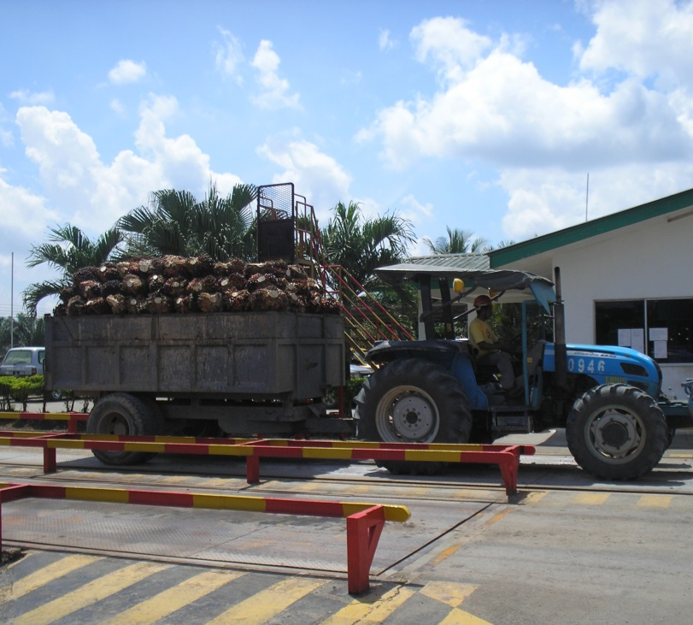
Harvesting Palm Oil
After they are harvested, the fresh fruit bunches need to reach a mill within 24 hours in order to produce the best yield (the maximum amount of oil extraction).
Each FFB weighs 40-60 lbs.
Each oil palm produces 1-3 FFBs per month.
(FFB = fresh fruit bunch)

Slide 9
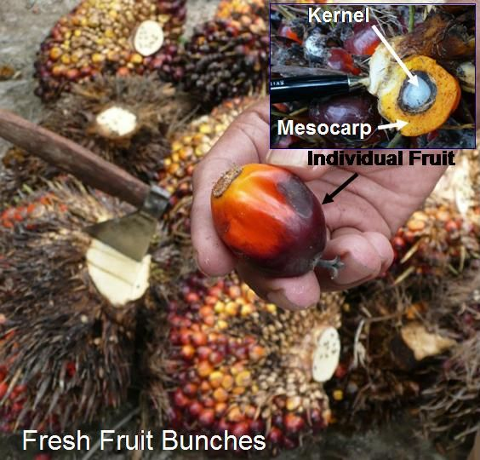
Harvesting Palm Oil
Palm kernel oil is made from the white center.
Palm oil is made from the mesocarp, the yellow fruit flesh.

Slide 10
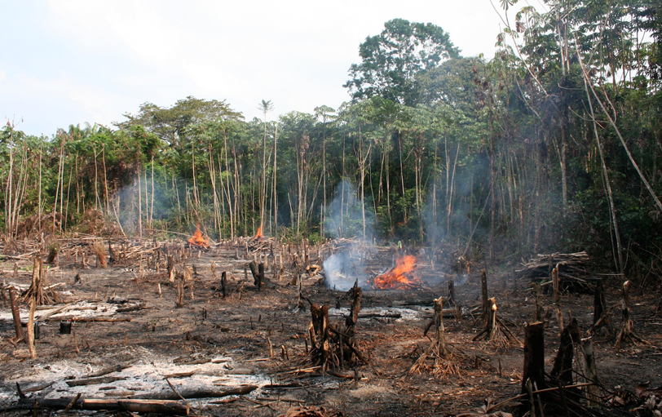
What’s the Problem?
Rainforest and peat land (swampy areas with special carbon-rich soil) in Indonesia and Malaysia are being cleared to make way for new palm oil plantations.

Slide 11
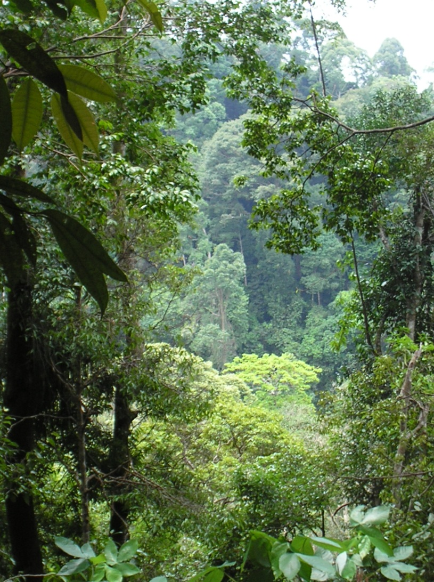
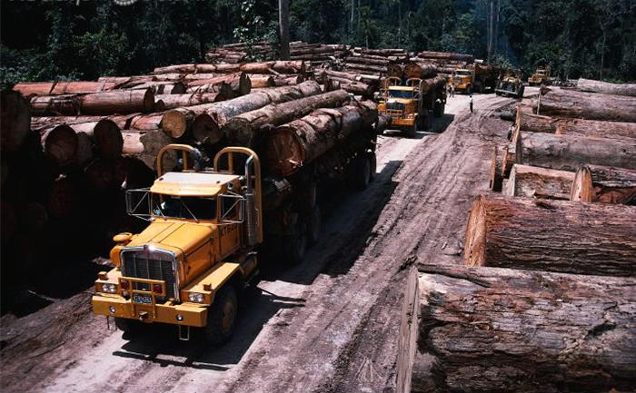
What’s the Problem?
Some companies clear excess forest to get more money for wood and paper products.

Slide 12
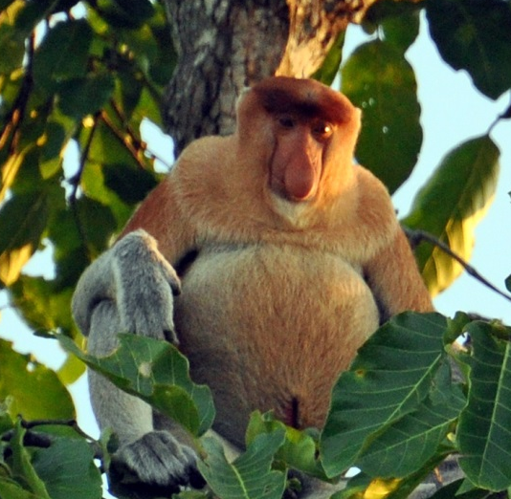

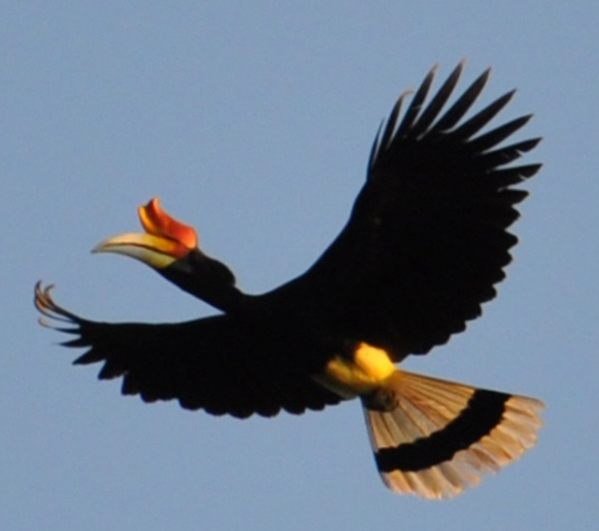
What’s the Problem?
Many species live in these rainforests, including orangutans, gibbons, elephants, rhinos, tigers, clouded leopards, hornbills, sun bears, and more.
Massive amounts of carbon are released into the atmosphere through deforestation, fires and draining peat swamps.

Slide 13


What’s the Goal?
To have healthy populations of orangutans, elephants, rhinos, tigers and other threatened and endangered species.
To save critical habitat.
Make sustainable palm oil the norm.

Slide 14
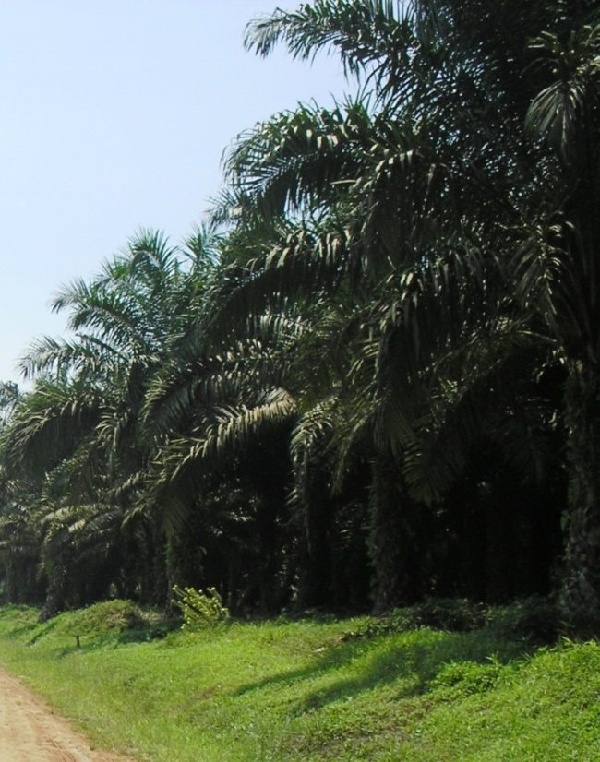
What’s the Solution?
Produce palm oil sustainably.
Support the Roundtable on Sustainable Palm Oil (RSPO).
Increase demand for RSPO certified sustainable palm oil that is deforestation-free.

Slide 15



What is the RSPO?
An international multi-stakeholder initiative transforming markets to make sustainable palm oil the norm.

Slide 16
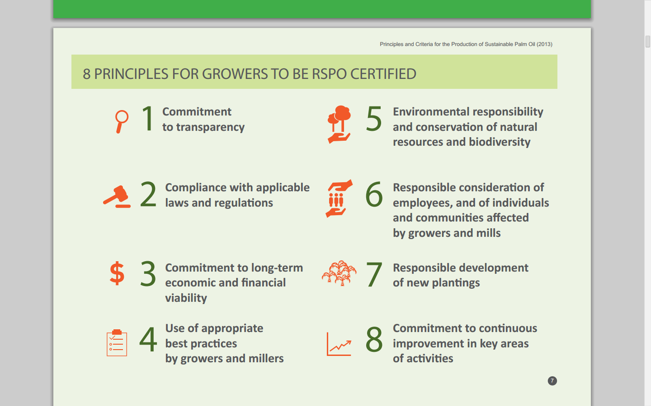
RSPO Principles
Source: RSPO

Slide 17
What Makes Sustainable Palm Oil Sustainable?
No HCV (high conservation value) land was cleared since 2005.
HCV assessments prior to clearing land.
Protection of endangered species.
Protection of land of cultural value to indigenous groups.
Conflicts with wildlife are handled appropriately.
If HCV land was cleared by an RSPO member, there is a compensation mechanism in place.
Land is reused; dead plants replaced right away.

Slide 18
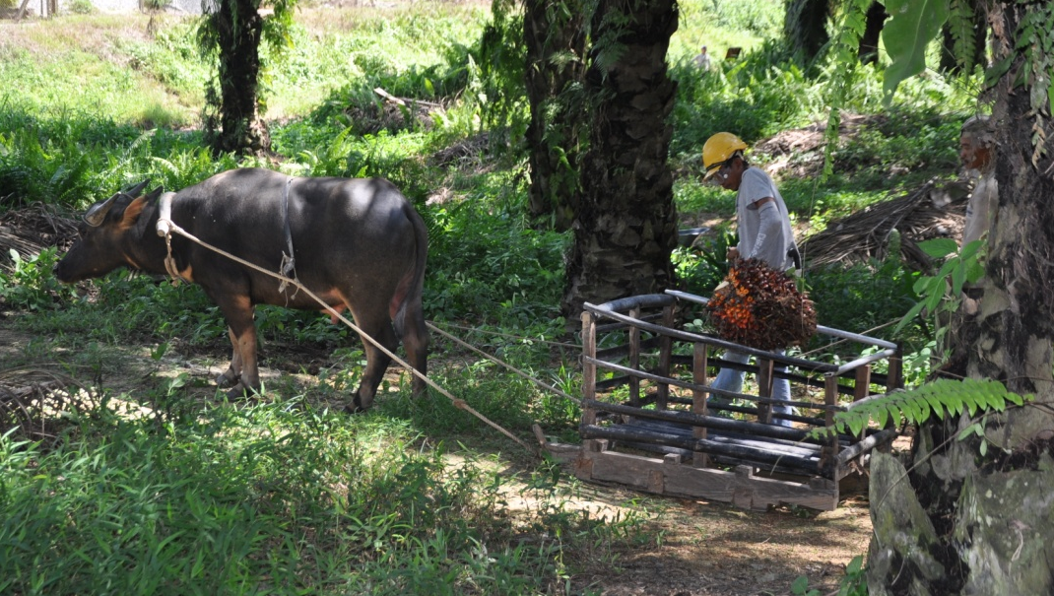
What Makes Sustainable Palm Oil Sustainable?
Fertilizer is used properly—producing high yields means less land needed.
Pesticides/herbicides are used responsibly.
Better treatment of workers & families (no slave labor).
GHG (green house gas) monitoring and reduction.

Slide 19
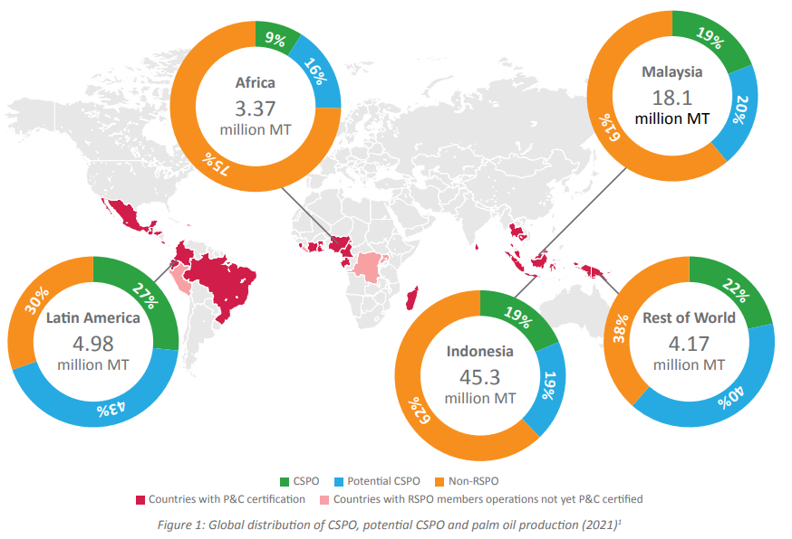
Global CSPO Production
Source: RSPO Impact Report 2022

Slide 20
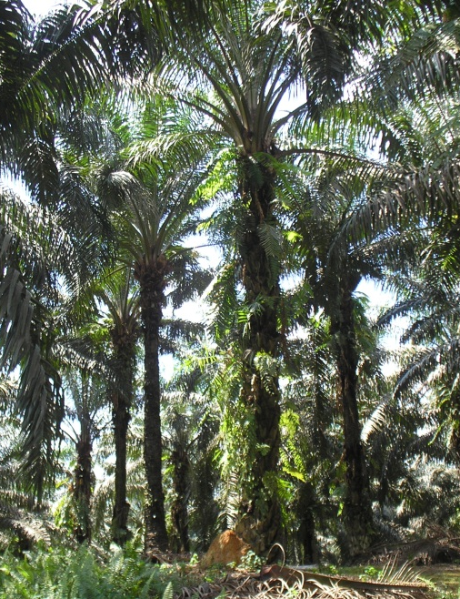
Challenges of the RSPO
Certifying smallholders is difficult.
Market uptake not high enough.
Conservationists say criteria is not strict enough.
Growers say criteria is too strict.

Slide 21
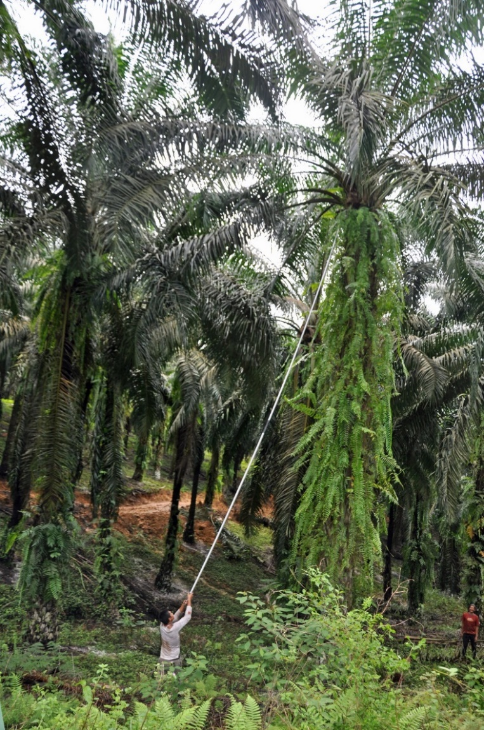
Challenges of the RSPO
Certifying Smallholders
Definition of smallholder: Farmers controlling 50 hectares or less of cultivated land .
RSPO estimates that there are at least 7 million palm oil smallholders globally.
Current number of RSPO certified smallholders: 165,462
Source: RSPO Impact Report 2022
Notes:
Source: https://rspo.org/smallholders

Slide 22
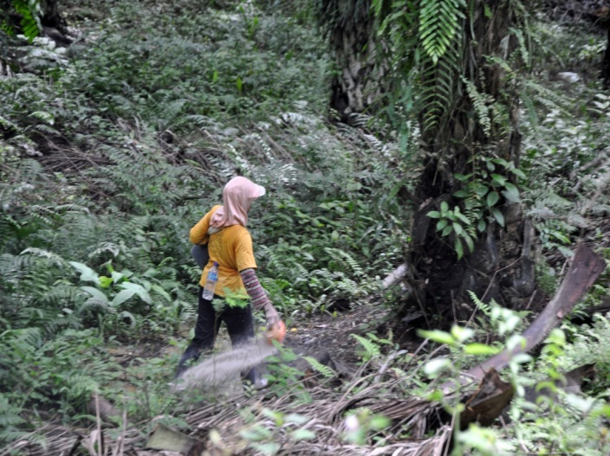
Making it Possible for More Smallholder Plantations to be Certified
Challenges of the RSPO
Over 40% of all palm oil plantations are owned by smallholders.
Privately owned plantations or co-ops; harder to reach them; fewer resources.
Lower wages.
Lower yield.
The RSPO is working on solutions (RSPO Smallholder Standing Committee (SHSC)).

Slide 23
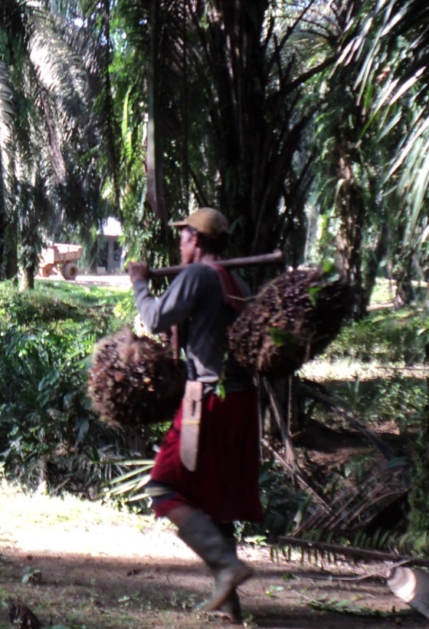
Challenges of the RSPO
Uptake of CSPO is too low
Low uptake does not push sustainability forward.
Growers put time, money, effort into getting a plantation certified.
These growers should be paid a little more (the premium) for the CSPO.
The uptake of CSPO is less than 50%:
Less than half of CSPO is sold at a fair price, which fairly compensates some growers.
Over half of the CSPO is sold at the lower non-certified price. This does not encourage growers to certify more plantations

Slide 24
Challenges of the RSPO
Uptake of CSPO is too low
Manufacturers and retailers who are members of the RSPO must submit time-bound plans – when they will be using 100% CSPO.
If CSPO is available they should use/purchase it – INCREASE UPTAKE.
This will drive demand for CSPO.
If there is more demand and they are fairly compensated, growers will certify more plantations.
This is where zoos and consumers can really make a difference:
If zoo guests support RSPO member companies, and demand companies use CSPO, UPTAKE WILL INCREASE.

Slide 25
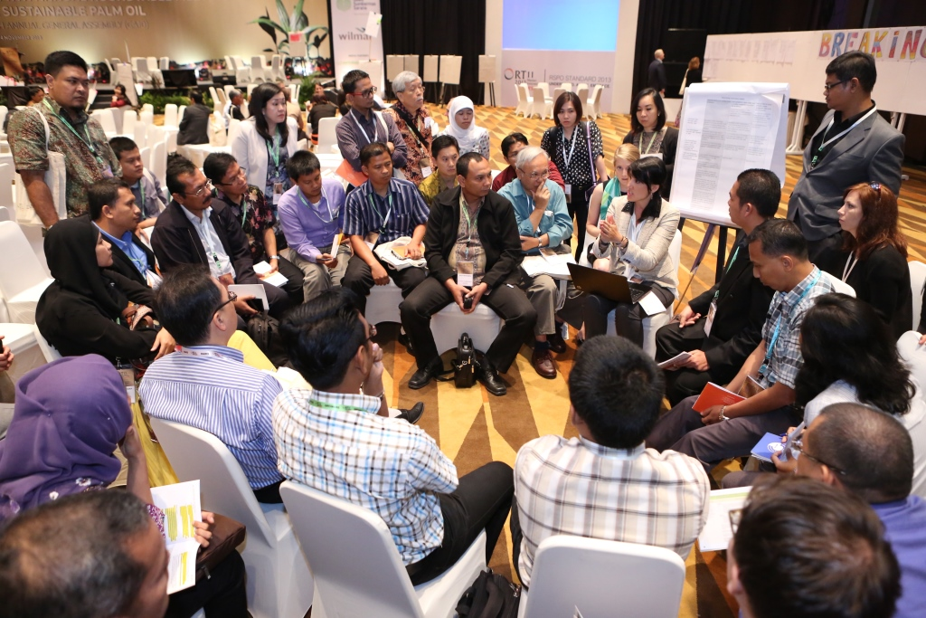
Challenges of the RSPO
Stakeholders have different perspectives
Conservationists say criteria are too lax.
Growers say criteria are too strict.
However - Different stakeholders coming together to make decisions, moving the industry forward to sustainability…
…that is the purpose of the
Roundtable on Sustainable Palm Oil

Slide 26
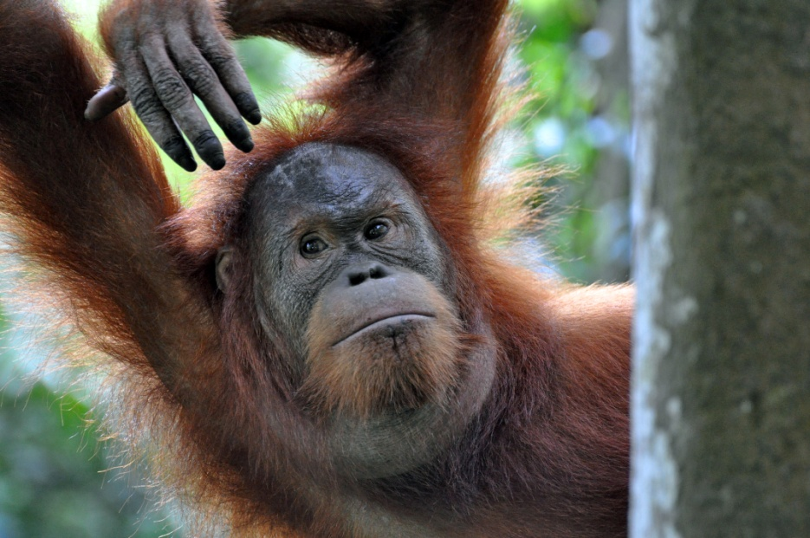
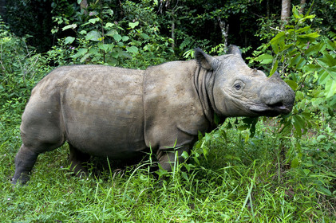
Why Support the RSPO
It is the only multi-stakeholder entity working toward sustainable palm oil.
It is the most effective vehicle to reach sustainability in the palm oil industry.
The RSPO is making measurable progress.

Slide 27

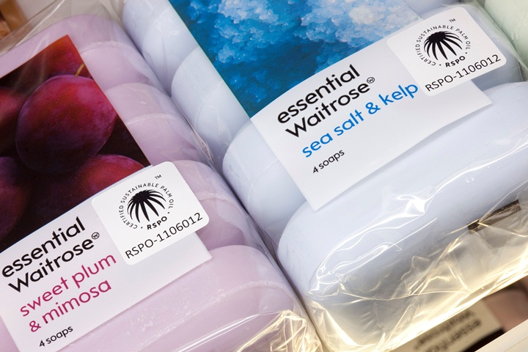
RSPO Making Progress - Trademark
RSPO Trademark / Logo tells consumers that the
product contains certified sustainable palm oil.
1,676 trademark licenses issued by RSPO
Source: RSPO Impact Report 2022

Slide 28
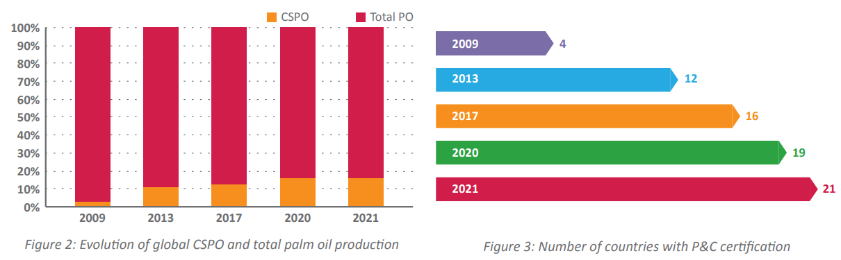
RSPO Making Progress - CSPO
Image Source: RSPO Impact Report 2022

Slide 29
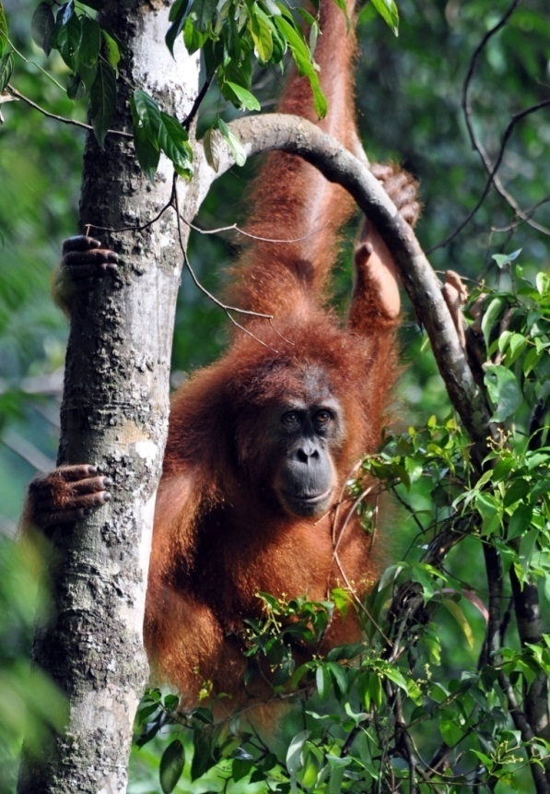
Why Zoos Should Join the RSPO
Zoos can change the industry…using the RSPO as the vehicle!
Zoos can propose resolutions to RSPO as a member of the General Assembly.
Demand traceability.
Honor your animals’ captivity by promoting conservation efforts in their native lands to protect wild species.

Slide 30
RSPO Members (E-NGO)
WWF
FFI (Fauna & Flora International)
Wetlands International
BOSF (Borneo Orangutan Survival Foundation)
Conservation International
Orang Utan Republik Foundation
World Resources Institute
Orangutan Land Trust
SOS (Sumatran Orangutan Society)
Global Environment Centre
HUTAN Kinabatangan Orang-utan Conservation Programme
Earth Innovation Institute
The RSPO has strong support and is helping the industry move towards sustainable palm oil.

Slide 31



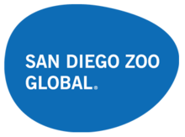













RSPO Members (Zoos and Aquariums)
Notes:
Cheyenne Mountain Zoo Nov. 2010, Zoological Society of London July 2011, San Diego Zoo Global Oct. 2012, Indianapolis Zoo June 2013, Zoo Atlanta Feb. 2015, Woodland Park Zoo April 2015, Zoological Park Board of NSW/Taronga Conservation Society Nov. 2015, Kansas City Zoo May 2016, Oklahoma City Zoo Oct. 2016, Naples Zoo May 2017, Wildlife Reserves Singapore Aug. 2018, Oregon Zoo Aug. 2018, WAZA Oct. 2018, AZA Jan. 2019, Auckland Zoo May 2019, Zoos Victoria July 2019, Saint Louis Zoo Aug. 2019, Sydney Zoo November 2019

Slide 32
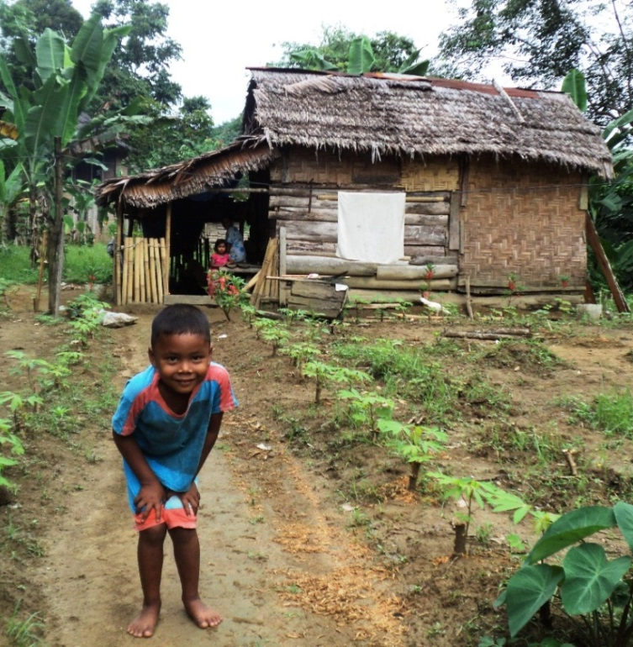
Why Boycotting is not the Solution
Indonesia and Malaysia are developing countries and need ways to drive their economies.
We realize that palm oil would be replaced with another crop that could cause worse environmental problems (like soy in the Amazon).
Indonesia, China and India are the world’s largest consumers of palm oil, so a boycott in the US wouldn’t change much in terms of global consumption.

Slide 33
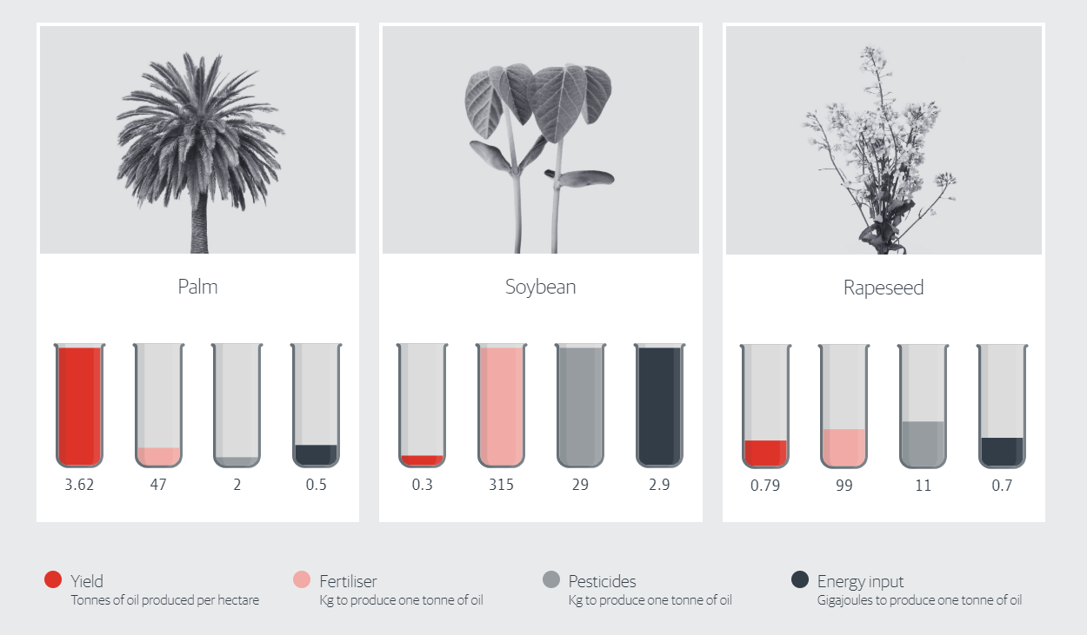
Why Boycotting is not the Solution
Oil palms can produce 4-10 times more oil per parcel of land than other oil crops.
Which means:
Less land is needed to produce more oil.

Slide 34
It is next to impossible to really know if a product is palm oil free.
Example of 600+ Names for Palm Oil & Derivatives
arachamide mea
capric triglyceride
caprylic triglyceride
caprylyl glycol
cetyl alcohol
cocoa butter equivalent (CBE)
cocoa butter substitute (CBE)
elaeis guineensis
emulsifier (some can be palm oil derived)
epoxidized palm oil (UV cured coatings)
ethylene glycol monostearate
ethylhexyl palmitate
fatty alcohol sulphates
glyceryl stearate
isopropyl
isopropyl palmitate
mono-glycerides of fatty acids
myristoyl
octyl palmitate
oleyl betaine
palm kernel oil
palm oil
palm olein
palm stearine
palmitate
palmitoyl oxostearamide
palmitoyl tetrapeptide-3
peg-100 stearate
peptide complex
saponified elaeis guineensis
sls
sodium lauryl
sodium lauryl sulphate
sodium lauryl sulfate
sodium lauryl sulfoacetate
sodium palm kernelate
sodium palmate
sodium stearate
sodium laureth sulfate
sodium laureth sulphate
sodium lauroyl lactylate
stearamidopropyl dimethylamine
steareth-2
steareth-20
steareth-21
stearic acid
vegetable oil
vitamin A palmitate

Slide 35
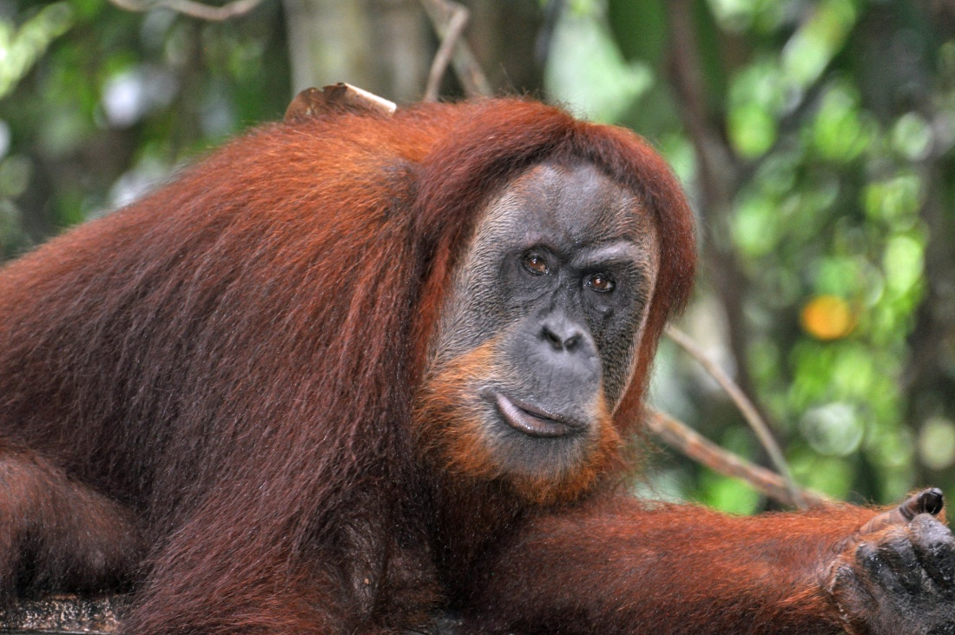
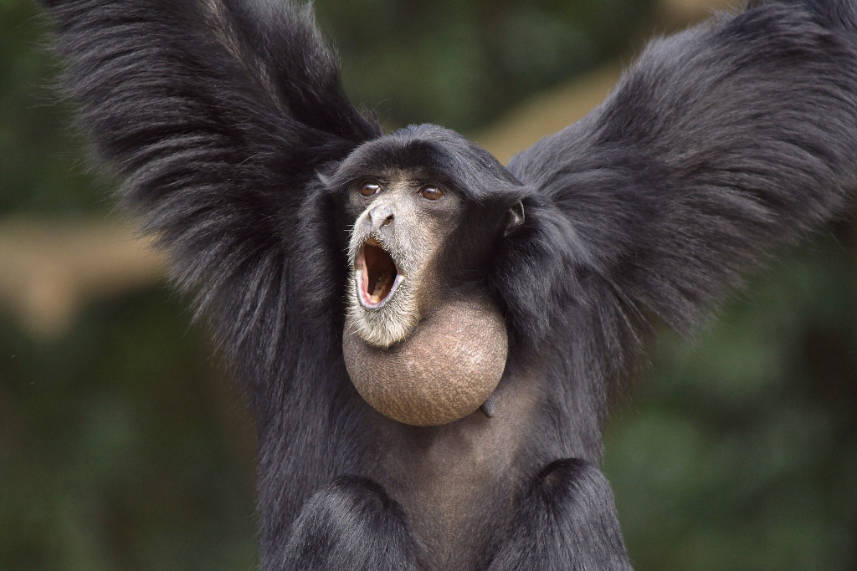
Messaging for Zoos & Aquariums
For more than a decade, Cheyenne Mountain Zoo has facilitated a palm oil awareness survey of US Zoos.
Results are showing that progress is being made
toward a unified message about sustainable palm oil.

Slide 36
Consistent Messaging is Key
Palm Oil Messaging in N. American Zoos & Aquariums 2011, 2014, 2020

Slide 37




What Zoos & Aquariums can do to Help
Share sustainable palm oil messages & action steps on social media.

Slide 38

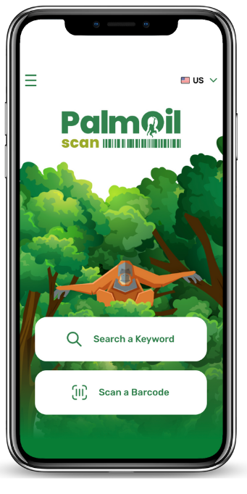

Promote WAZA’s PalmOil Scan app
What Zoos & Aquariums Can Do to Help
Available on the
App Store and Google Play
www.cmzoo.org/palmoilscan

Slide 39
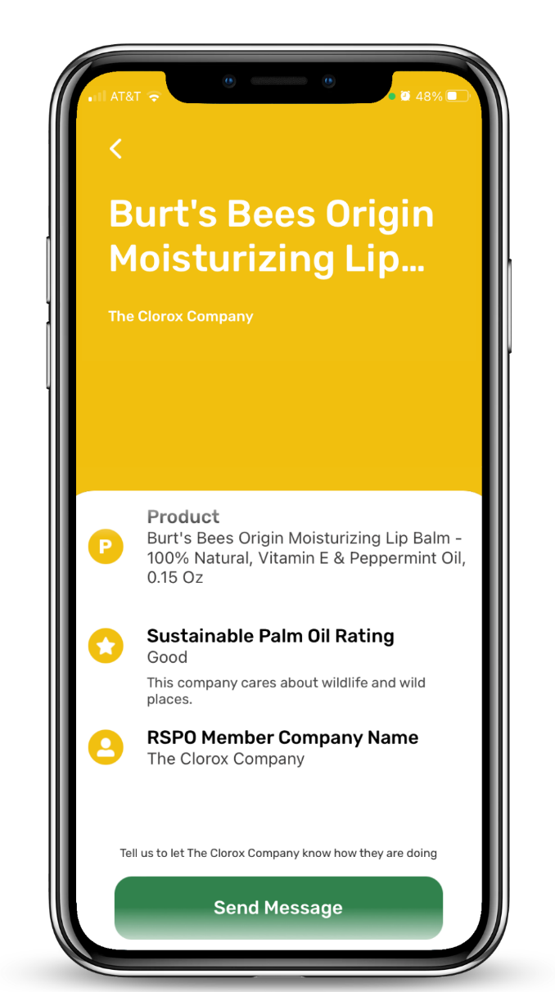
App Rating System
Green = Excellent
Yellow = Good
Orange = Poor
Red = No Commitment
Companies receive a score based on:
Membership to the RSPO
Amount of CSPO out of their total palm oil usage
Public, time-bound commitment to using 100% CSPO within the next 5 years.
ACOP submission

Slide 40
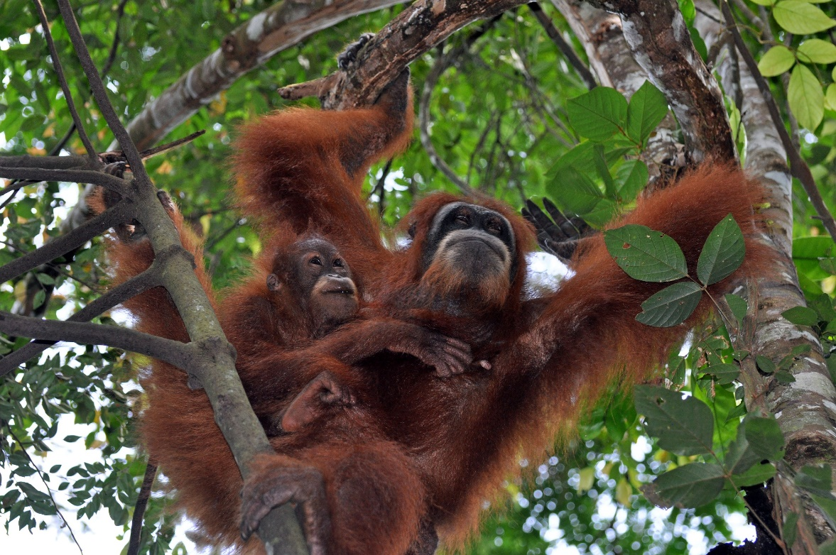
What Zoos & Aquariums Can Do to Help
Join the RSPO and be part of the solution with your voting power.

Slide 41
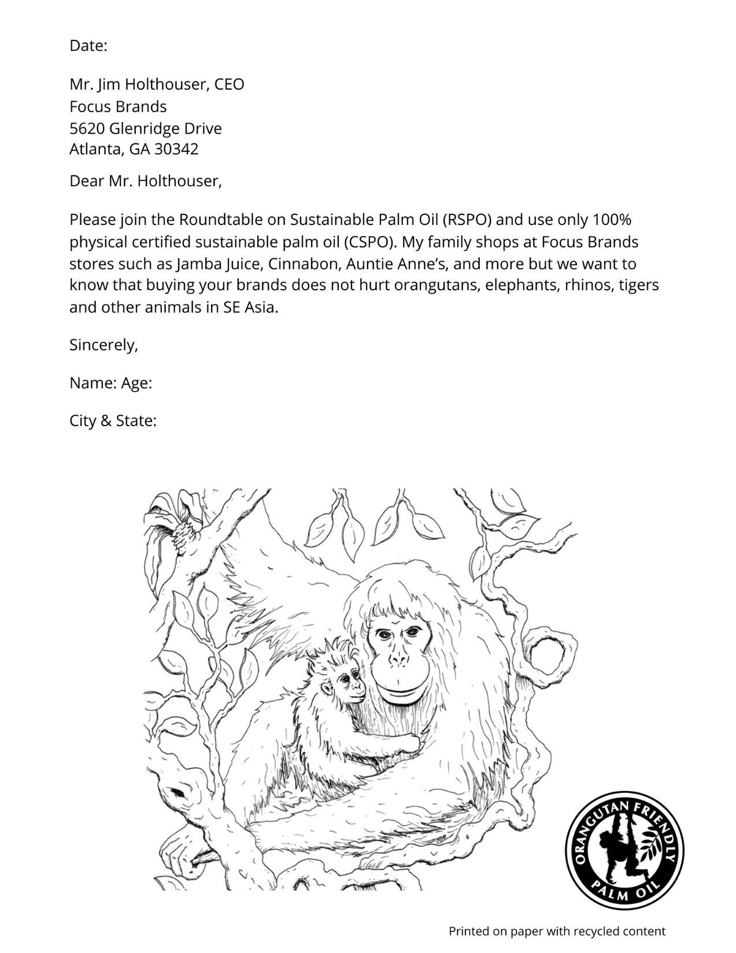
Give guests a way to take action
What Zoos & Aquariums Can Do to Help
Offer coloring sheets for kids with letters asking companies to source CSPO (see picture).
Offer petitions for guests to sign and mail them to companies that need to join the RSPO.
Have guests download the PalmOil Scan app and use it while shopping.

Slide 42
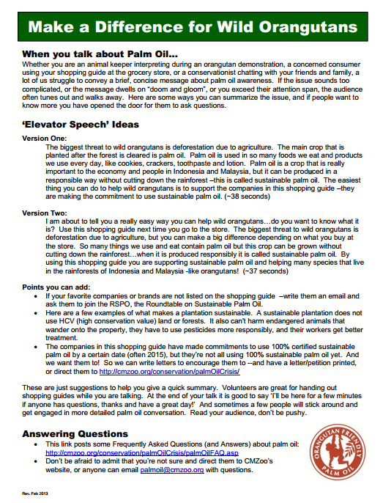
What Zoos & Aquariums Can Do to Help
Have conversations with guests
Tell guests about palm oil and how it can affect orangutans, tigers, etc.
“Elevator speech” ideas can be downloaded at cmzoo.org/palmoiltoolkit

Slide 43
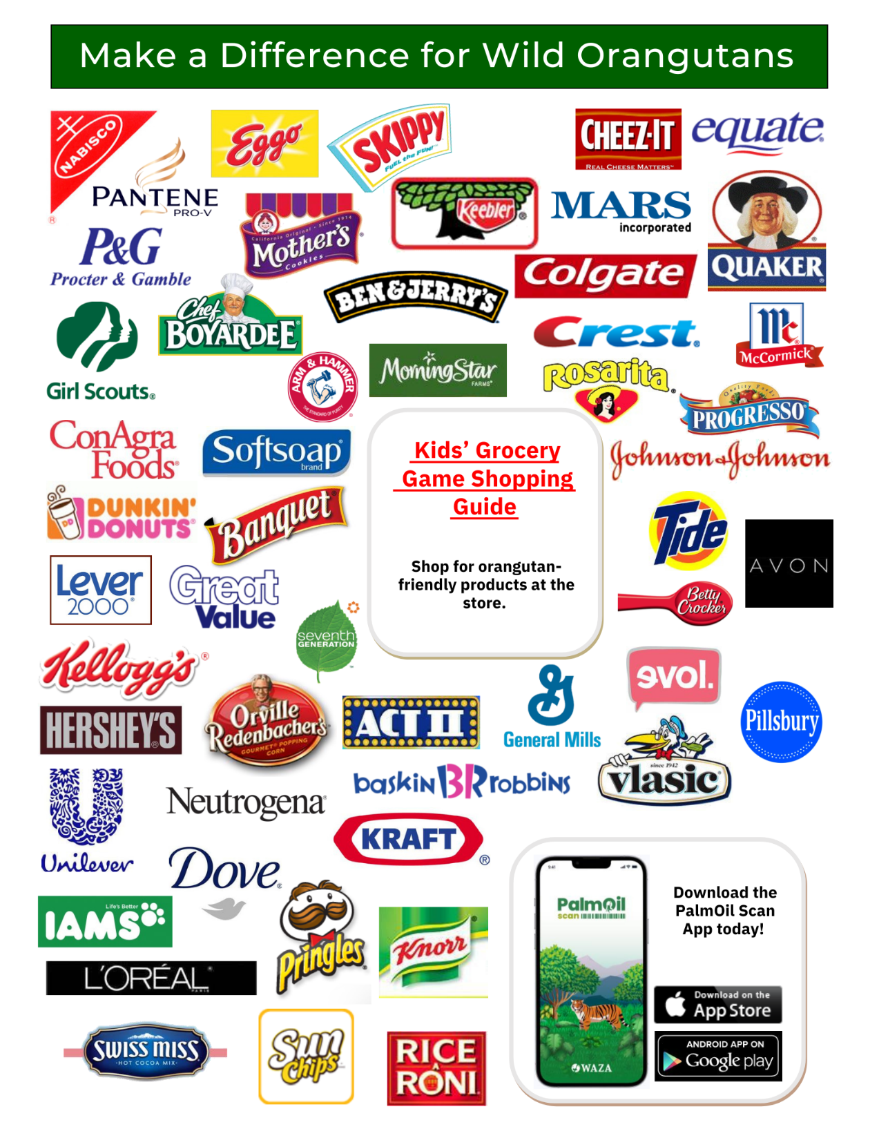
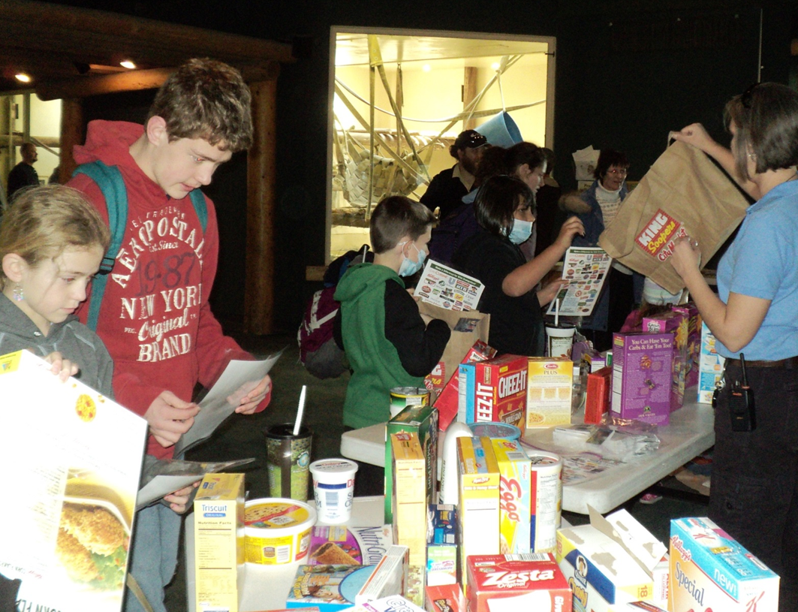
The grocery game shows guests that using a shopping guide can help them make orangutan-friendly choices at the grocery store.
What Zoos & Aquariums Can Do to Help
Engage younger guests with games
Available at cmzoo.org/palmoil

Slide 44
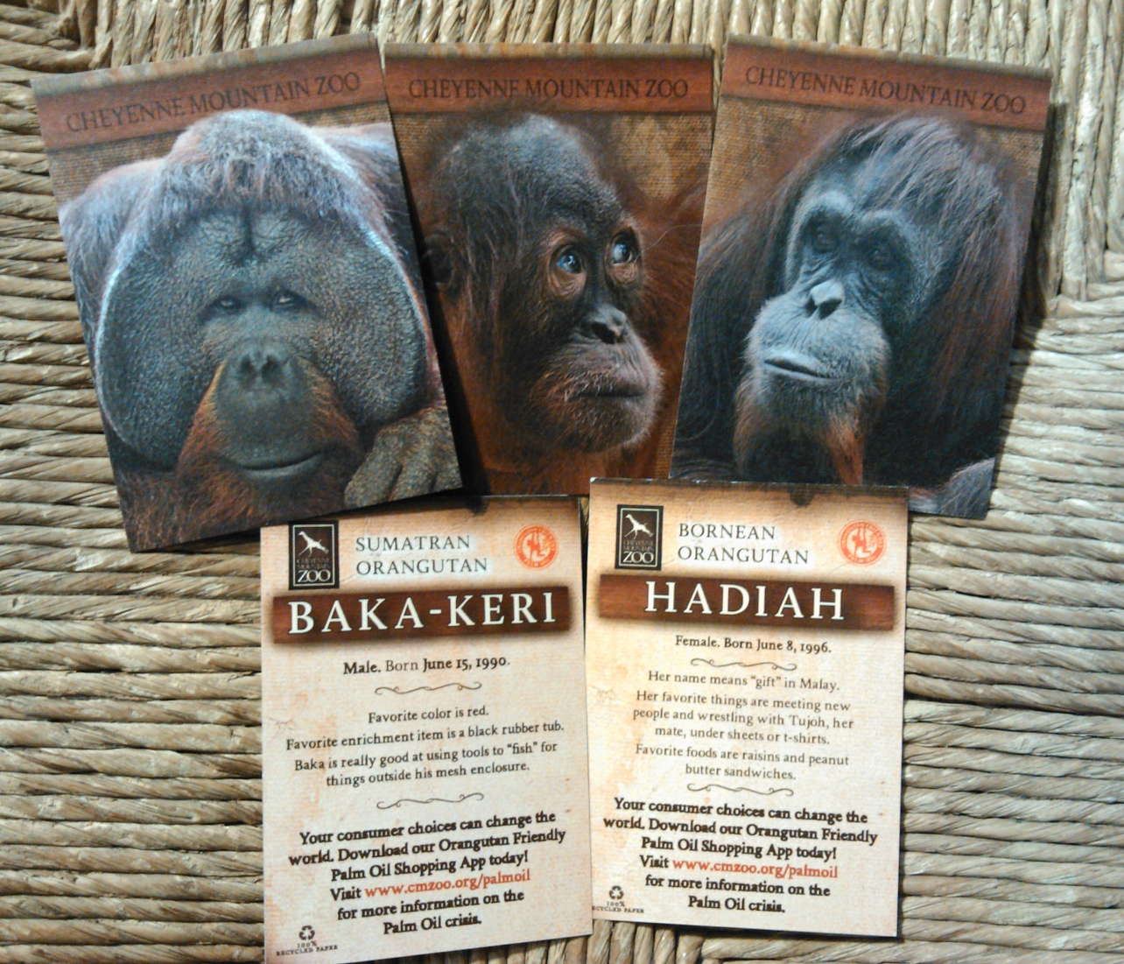
Connect Guests with Animals
What Zoos & Aquariums Can Do to Help
Create trading cards of animals at your zoo, affected by the palm oil crisis
Orangutans, tigers, tapirs, pangolins, etc.

Slide 45
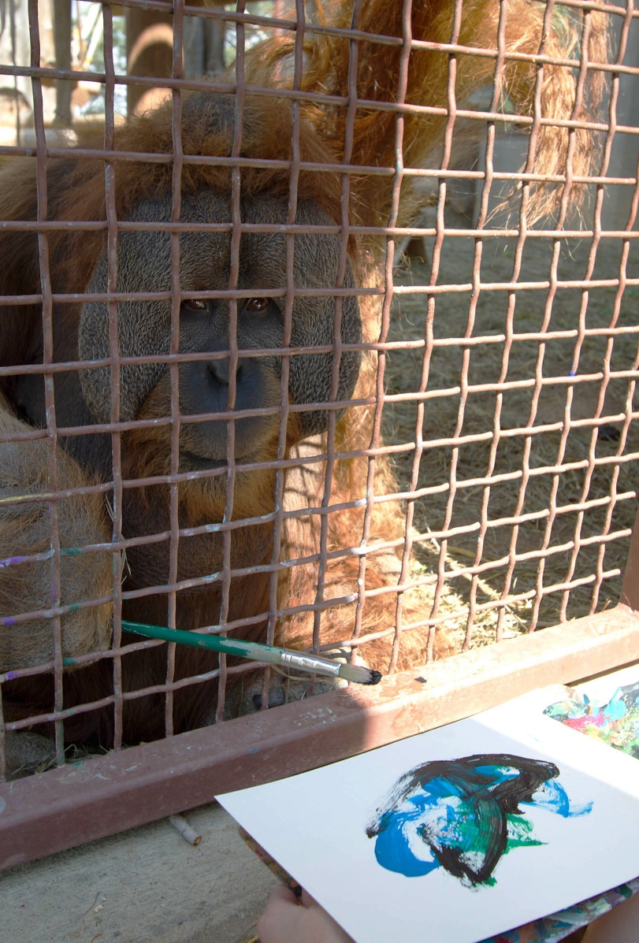
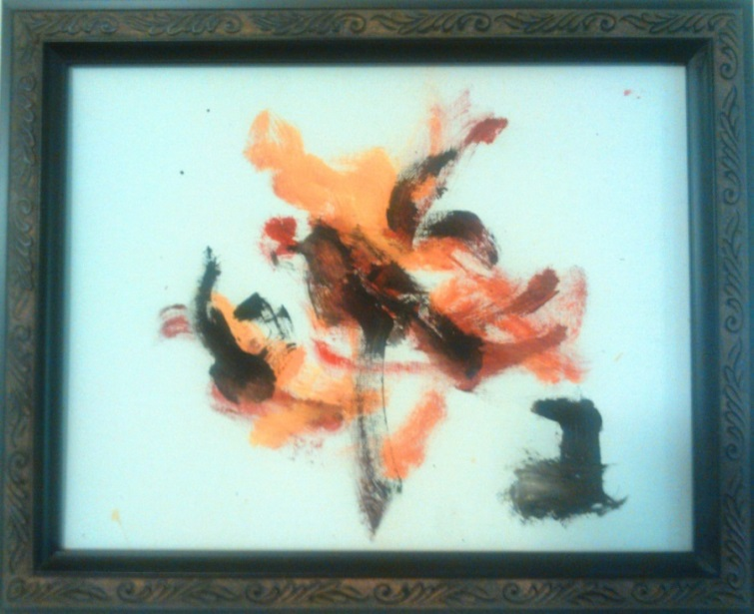
Engage Guests - Animal Art
What Zoos & Aquariums Can Do to Help
It is animal enrichment, animal training, we can talk about tool-use in zoos and in the wild.
It is also great for fundraising; proceeds can go to help wild orangutans.
With every piece of animal art you sell, you can include information about sustainable palm oil and action steps.

Slide 46
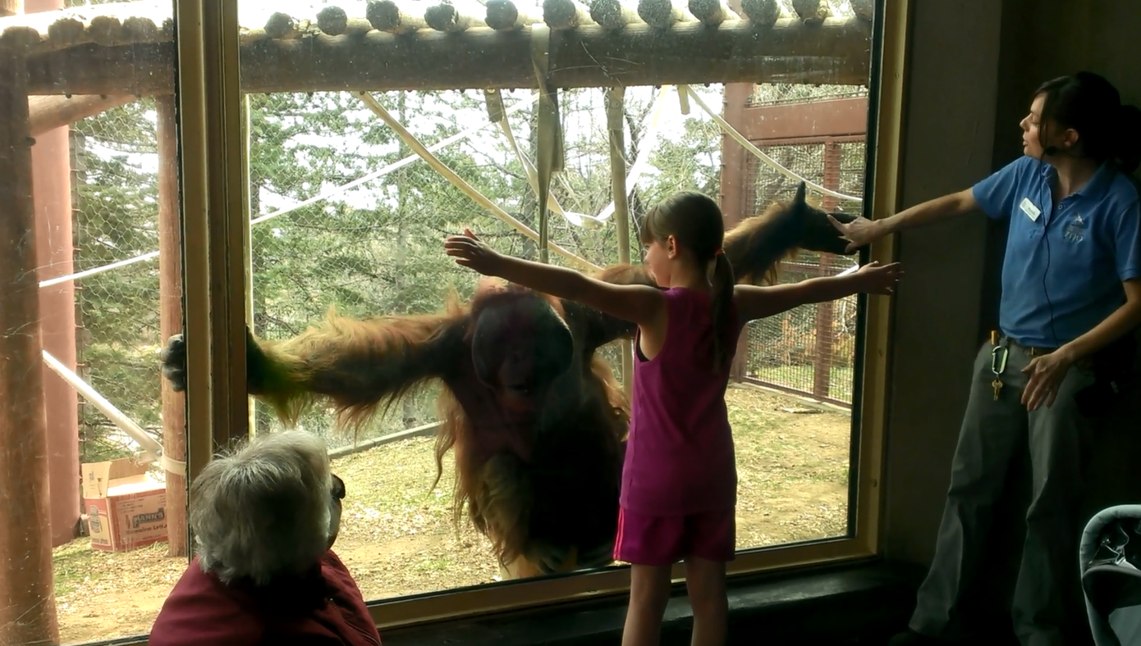
What Zoos & Aquariums Can Do to Help
Connect guests, share messages & action steps:
shows, demos, & keeper talks

Slide 47
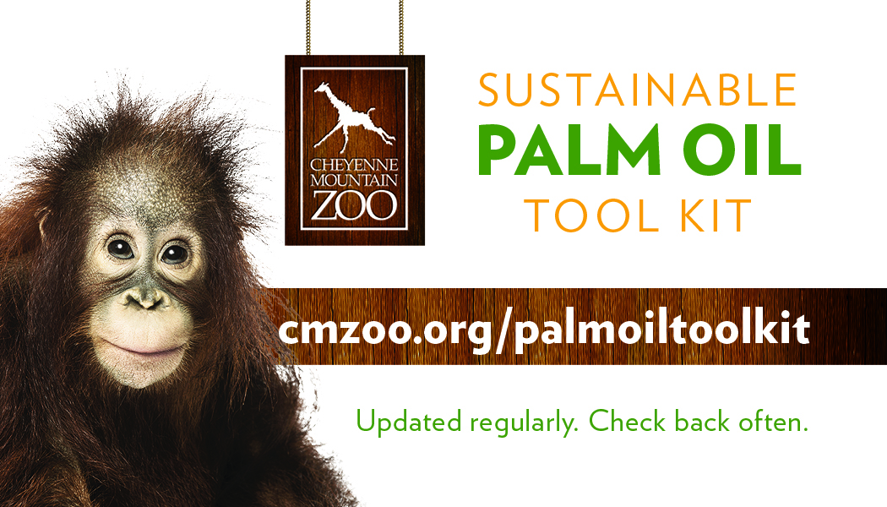
What Zoos & Aquariums Can Do to Help
Get the tools you need to move sustainable palm oil forward
Palm Oil Awareness Tool Kit
Visit cmzoo.org/palmoiltoolkit

Slide 48

What Zoos & Aquariums Can Do to Help
Find your own ways to engage guests
Share your ideas and tools with the zoo community

Slide 49
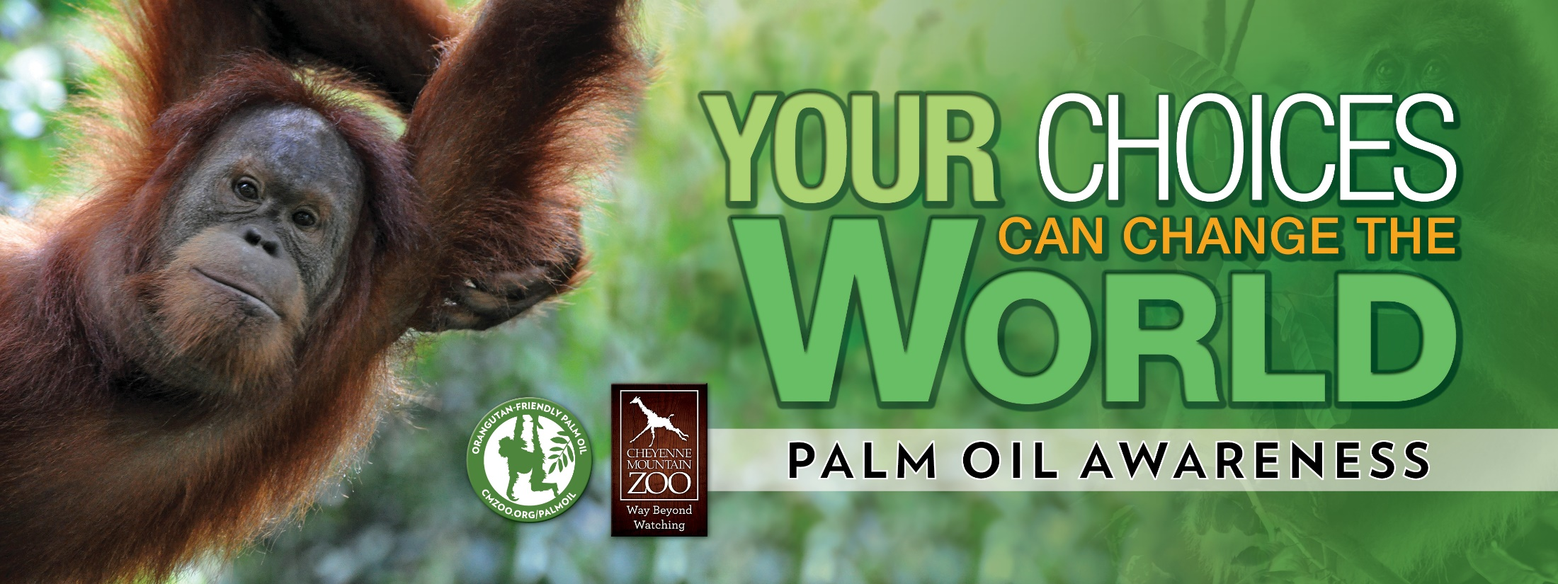
Let’s Make a Difference Together!
Notes:
49

